Slide 1
Analyzing Amazon Sales data
Tannu
July 2024

Slide 2


Tool used
Excel
Power Bi

Slide 3
introduction
In this project , I examine Amazon's sales performance from 2010 to 2017, uncovering key trends and insights. Our analysis reveals a fluctuating total profit trends with alternate years of increase and decrease from 2010 to 2014, then declined in 2015, slightly increased in 2016 and decreased again in 2017.
Unit sold follows a different pattern 66k units sold in 2010 and then decrease and increase over years.
Units sold of item and profit generated by item are independent of each other.

Slide 4
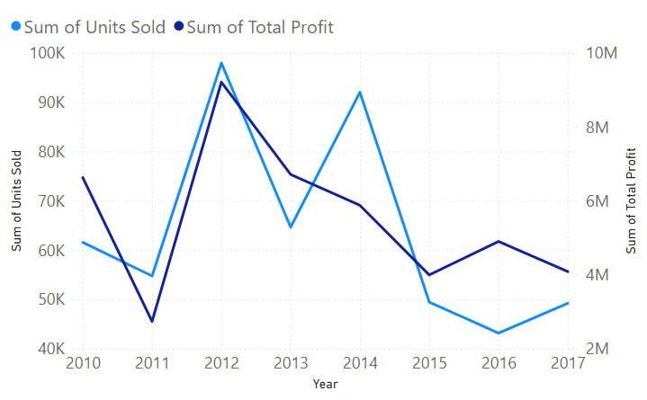
Unit sold and profit over years

Slide 5
Regional Profitability trends (2010 - 2017)
Sub Saharan Africa generated the highest profit followed by Europe and Asia
Sub-Saharan Africa's profit grew steadily from 2011 two 2014 after a low start in 2010
Europe was more profitable in 2010, 2012 aim 2016
Asia briefly surpassed Europe in 2015
Central America and Caribbean showed a surge in profit in 2017 making them the most profitable region that year.
North America yielded the lowest profit.

Slide 6
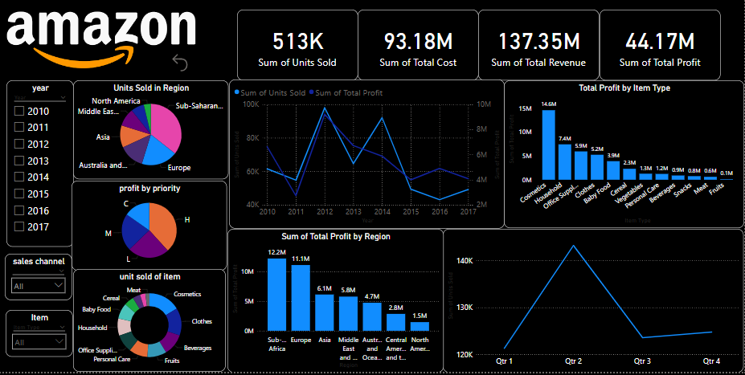
My design

Slide 7
Dashboard link : explore the data in depth
amazon project - Power BI

Slide 8
Product category profitability trends
Cosmetics generated the overall highest profit, followed by household and office supply.
fruit and meat yielded the lowest profit.
Clothes were 2nd highest profitable item in 2010 and 2015 generated highest profit in Australia & Oceania (2011) and Sub Saharan Africa(2015)
Baby food is the 2nd most profitable in 2014 generated highest profit in Europe.
Below table highlights the profitable item of the year and country in which they generated highest profit
2010 | 2011 | 2012 | 2013 | 2014 | 2015 | 2016 | 2017
Cosmetics | Office supplies | Household | Cosmetics | Cosmetics | Household | Cosmetics | Household
Europe | Sub Saharan Africa | Sub Saharan Africa | Middle East & North Africa | Sub Saharan Africa | Asia | Europe | Cental America and Caribbean

Slide 9
Yearly best seller and regions
Year | Highest sold item | Region
2010 | Clothes | Australia and Oceania
2011 | Beverages | Sub Saharan Africa
2012 | Personal Care | Sub Saharan Africa
2013 | Cosmetics | Middle East &North Africa Australia and Oceania
2014 | Beverages | Australia and Oceania
2015 | Clothes | Sub Saharan Africa
2016 | Cosmetics | Europe
2017 | Personal Care | Cental America and Caribbean

Slide 10
Regional best seller and profitable
Region | Best seller item | Profitable item
Sub Saharan Africa | Fruits | Office Supplies
Europe | Cosmetics | Cosmetics
Asia | Household | Household
Middle East & North Africa | Cosmetics | Cosmetics
Australia and Oceania | Baby food | Cosmetics
Central America and Caribbean | Household | Household
North America | Personal care | Household

Slide 11
Conclusion
In conclusion, the analysis of Amazon sale performance and profitability reveals several key insights. Sub-Saharan Africa generated the highest profit followed by Europe and Asia while North America yielded lowest profit.
Cosmetics were the overall best-selling product, followed by household and office supply while meat had the lowest sale
regionally, fruits were in high demand in sub-Saharan Africa, cosmetics in Europe, household in Asia and personal care item in North America.
while some region had consistent best-selling products, others had varying preferences across years.
Additionally, cosmetics and household items were profitable across multiple regions.
This study highlights the importance of regional market analysis and product diversification to cater to local demands, maximize profits and drive growth.

Slide 12
THANK YOU

